Slide 1

Flexible & Powerful Open Source Multi-Protocol Messaging

Slide 2


Slide 3
ActiveMQ by Apache
Developed by the Apache Software Foundation
Message-oriented middleware (MOM)
Allows loose coupling of the elements
Java based-makes use of the Java Message Service (JMS) API

Slide 4
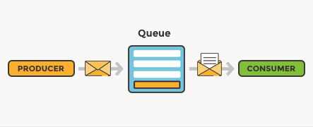
What is message queuing?
Allows applications to communicate by sending messages to each other.
Provides temporary message storage when the destination program is busy or not connected.

Slide 5

Normal message passing:
Producer
Consumer

Slide 6
What if the message gets lost?
Producer
Consumer
1
Producer
Consumer
2
What if the message order gets mixed?

Slide 7
?
Producer
Consumer
?

Slide 8

Consumer 1
?
Producer
Consumer 2
Consumer 3

Slide 9

Example by scenario:
The creation of WhatsApp if done with ActiveMQ

Slide 10
1.Client send requirements to Lead dev
Active MQ:
LeadDeveloper
Client 1
Developer 2
Client 2
Developer 3

Slide 11

2.Lead dev asking something(to elaborate) from separate clients
Active MQ broker:
LeadDeveloper
Client 1
Queue 1
Developer 2
Client 2
Queue 2
Developer 3
Can store messages in queue

Slide 12

3.Lead dev assigning tasks to other developers
Active MQ broker:
LeadDeveloper
Client 1
Queue 1
Developer 2
Client 2
Developer 3
Queue 2
Developer 4

Slide 13

How does ActiveMQ work?

Slide 14
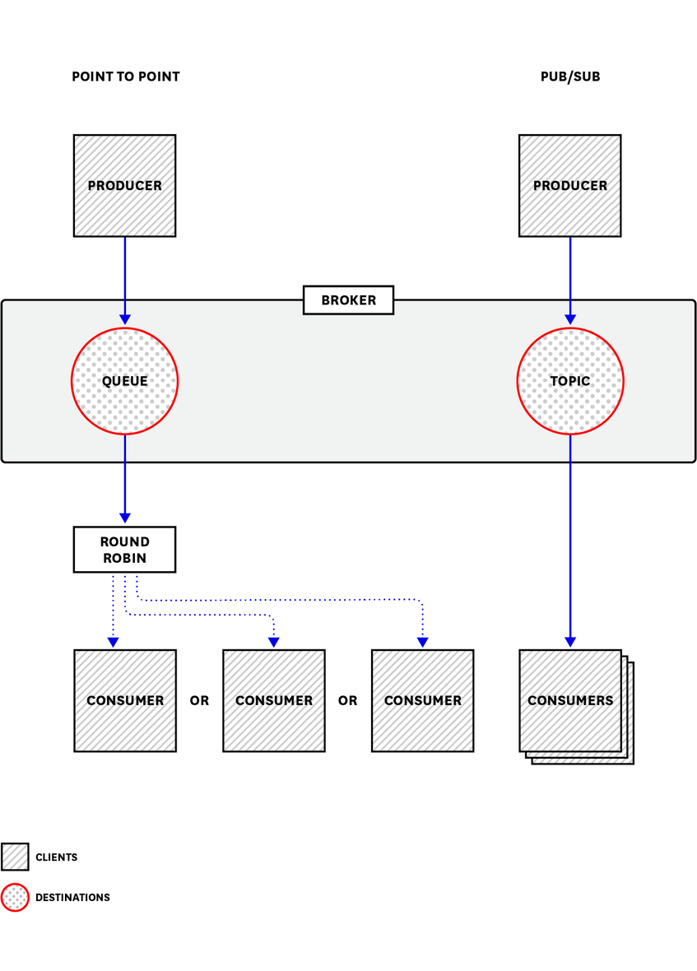
sends messages between client applications—producers, which create messages and submit them for delivery.
consumers receive and process messages.
The ActiveMQ broker routes each message through a queue

Slide 15
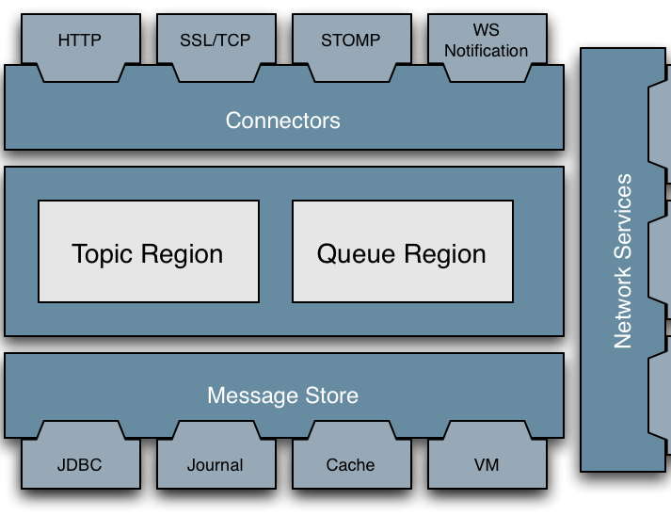
Architecture:

Slide 16
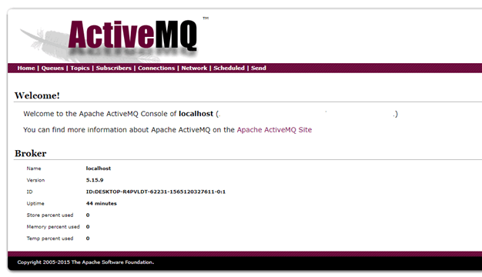
Once you have installed the ActiveMQ server it should be available at http://localhost:8161/admin

Slide 17
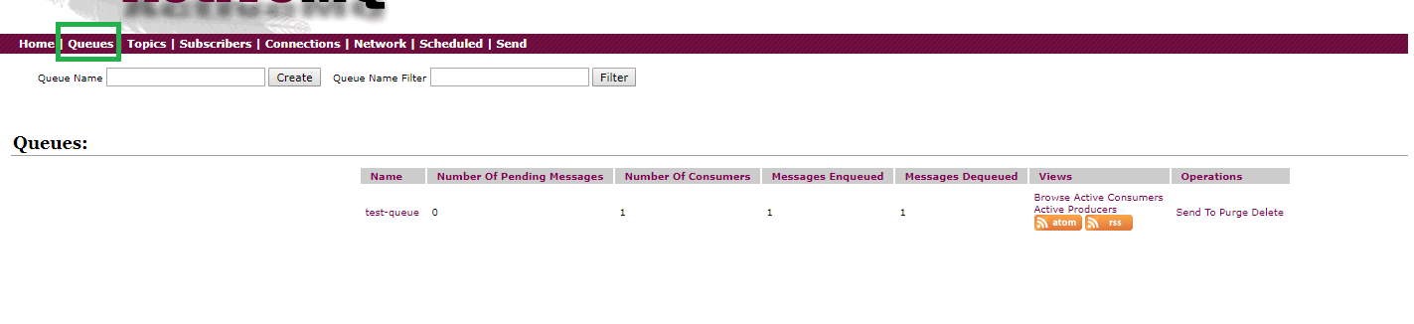
Dashboard stats:

Slide 18
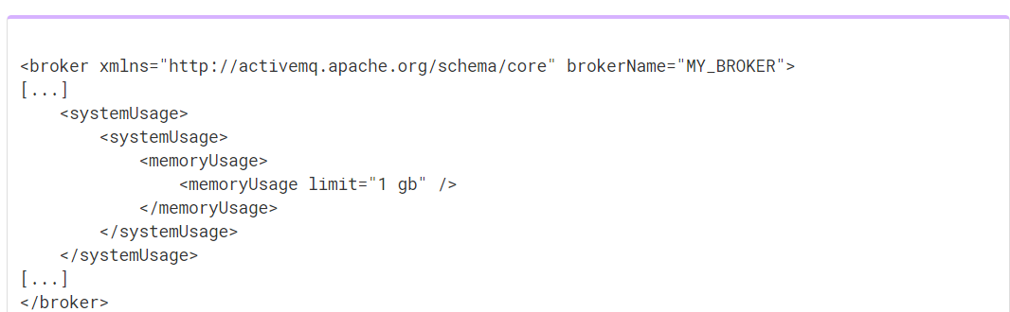
Memory:
Each message occupies some of the available memory until it is dequeued. Changeable in activemq.xml
How much memory depends on the size of the message.

Slide 19
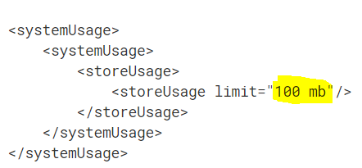

Storage:
KahaDB is ActiveMQ’s default message storage mechanism. It stores both persistent and non-persistent messages.

Slide 20

ActiveMQ metrics:
ActiveMQ metrics is a unique feature which can,
help you proactively maintain your messaging infrastructure
provide you with information you need to investigate,
errors
missing messages
unexpected latency.

Slide 21
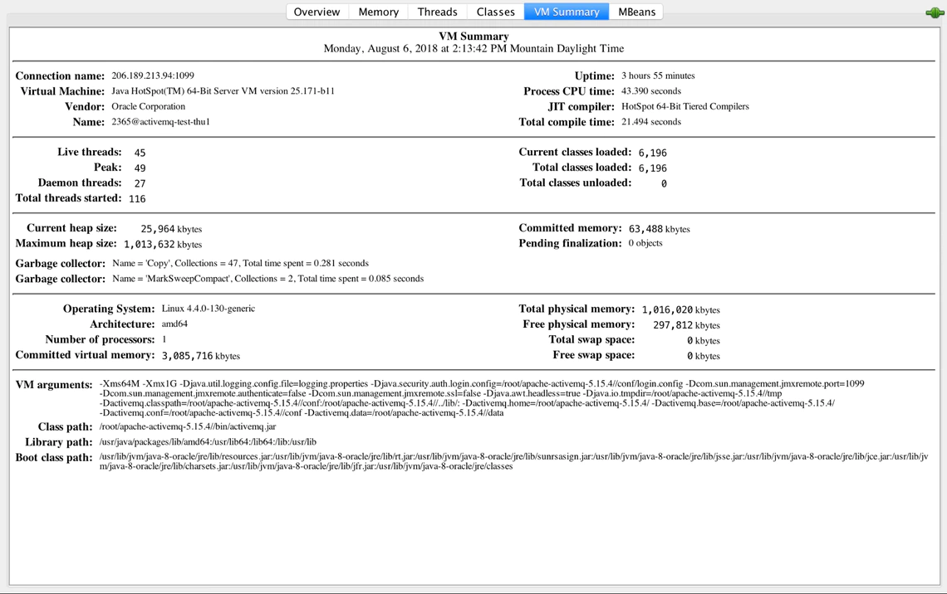
In addition to displaying metrics about ActiveMQ, JConsole shows you operating information about the JVM in which ActiveMQ is running. Under the VM Summary tab and Viewing ActiveMQ metrics in JConsole

Slide 22
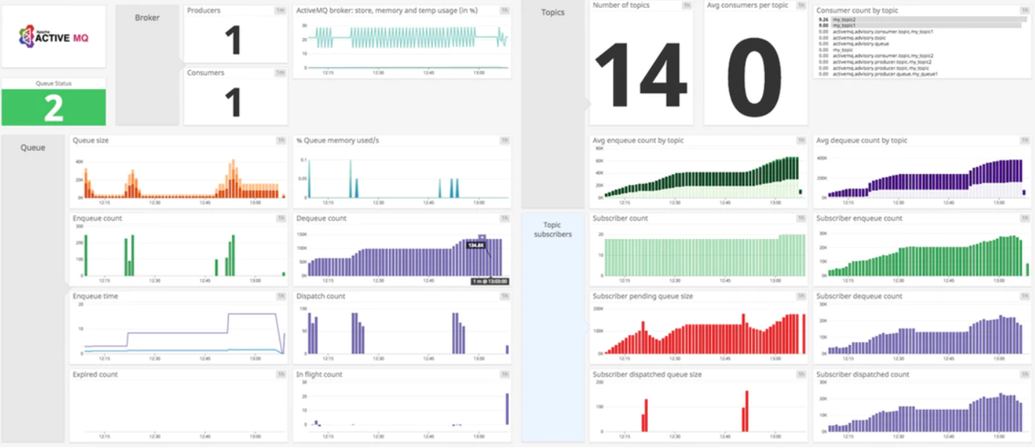

Slide 23



Organizations that use ActiveMQ
Lockheed :
Perform COTS integrations
Trimble:
To fulfill the need to perform the messaging between and the servers.
Caterpillar:
as a Message broker
Delta Dental of California
Sinclair Broadcast Group

Slide 24


Other similar applications to ActiveMQ
 | Open Source | Volume of Data they share | Performance | Reliability
 | YES | High (Huge volume of data streams) | High throughput | Very Reliable
 | YES | Less than 4096bytes | High throughput | Very Reliable (Since messages are stored in repositories )
 | YES | Depends on the requests. | High throughput | Reliable (Since Kafka is distributed,partioned,replicant and fault tolerance. )

Slide 25

Advantages
Open source
Allows applications build with different languages,OS and platforms to integrate with each other.
Location Transparency-Client applications doesn't need to know where the server applications are located.

Slide 26

Advantages contd.
Reliable Communications-Both the client and the server need not to be available at the same time.(due to the queues)
The size of the queue is dynamic(variable sized queues).

Slide 27

Advantages contd.
Less time consumption-Due to the asynchronous communication,instead waiting till the server sends a response-client can carry con the next set of operations.
Reduced coupling-The information(such as location,protocol and availability) of the service can be changed easily withour effecting the client.
Easy coding.(ActiveMQ uses JAVA where others use Erlang)

Slide 28
Disadvantages:

Slide 29

Group 5
members:
Thenuka
Uthpala
Janadhi
Uvindu
Viveka

Slide 30
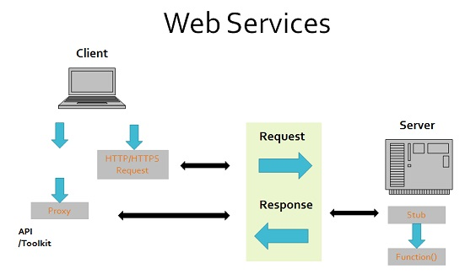

Q &A

